Slide 1
Cyclops Project
Data Science Division, Statistics Canada
Presentation 2 – November 4, 2019

Slide 2
Update on the OCR

Slide 3
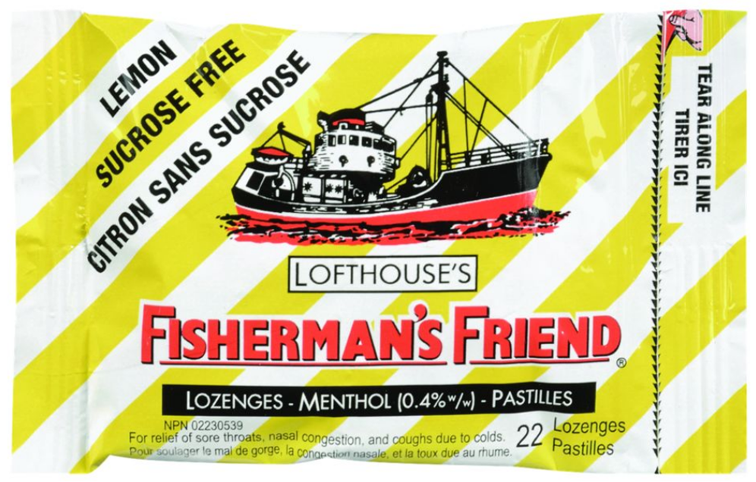
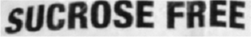
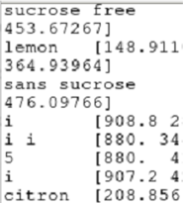
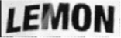
Can Read Slanted texts in images
image
Cropped images of words
Extracted text

Slide 4
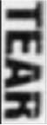
Cannot read vertical texts in images
image
Cropped images of words
Extracted text

Slide 5
Azure OCR misses many text

Slide 6
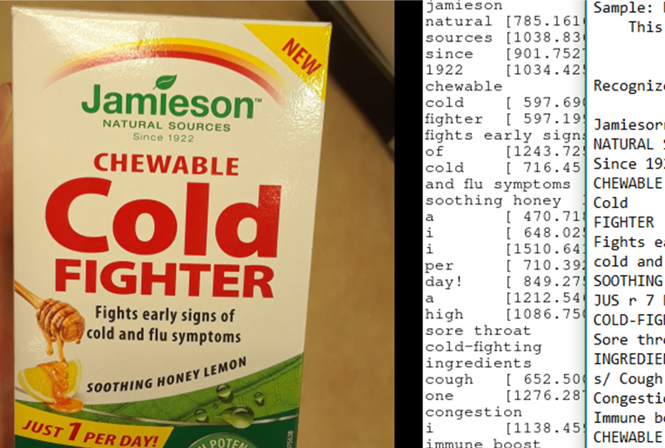
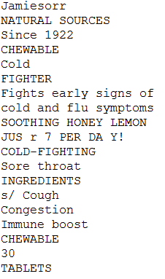
Front image
image
CRAFT
AZURE

Slide 7
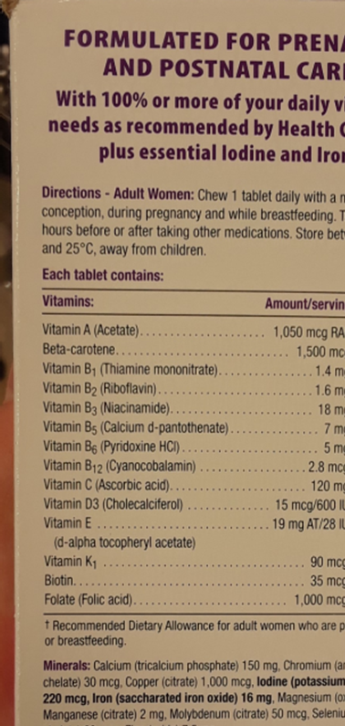
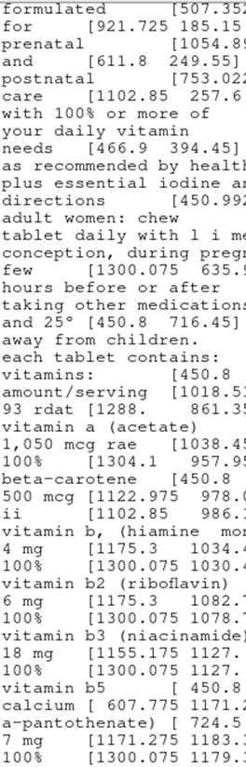
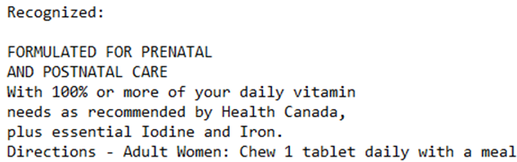
Back image
image
CRAFT
AZURE

Slide 8
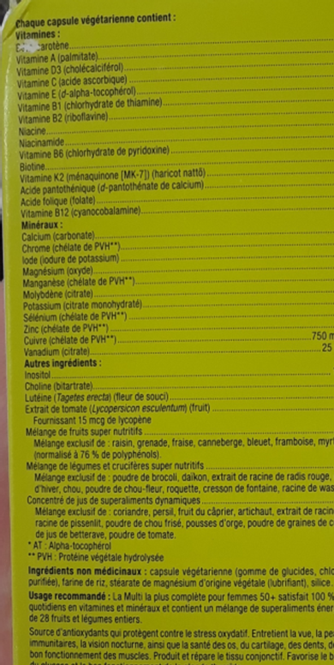
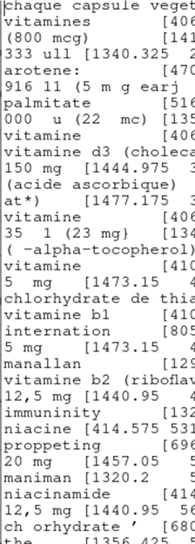
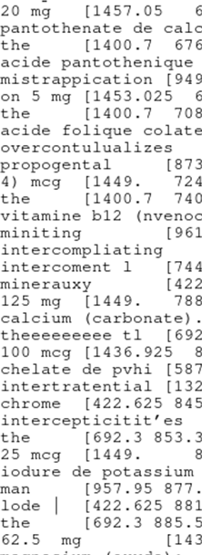
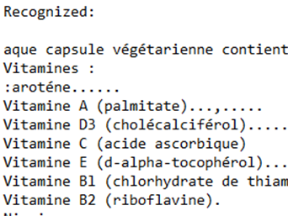
Back image
image
CRAFT
AZURE

Slide 9
Generating Initial Bounding Boxes: Claims

Slide 10
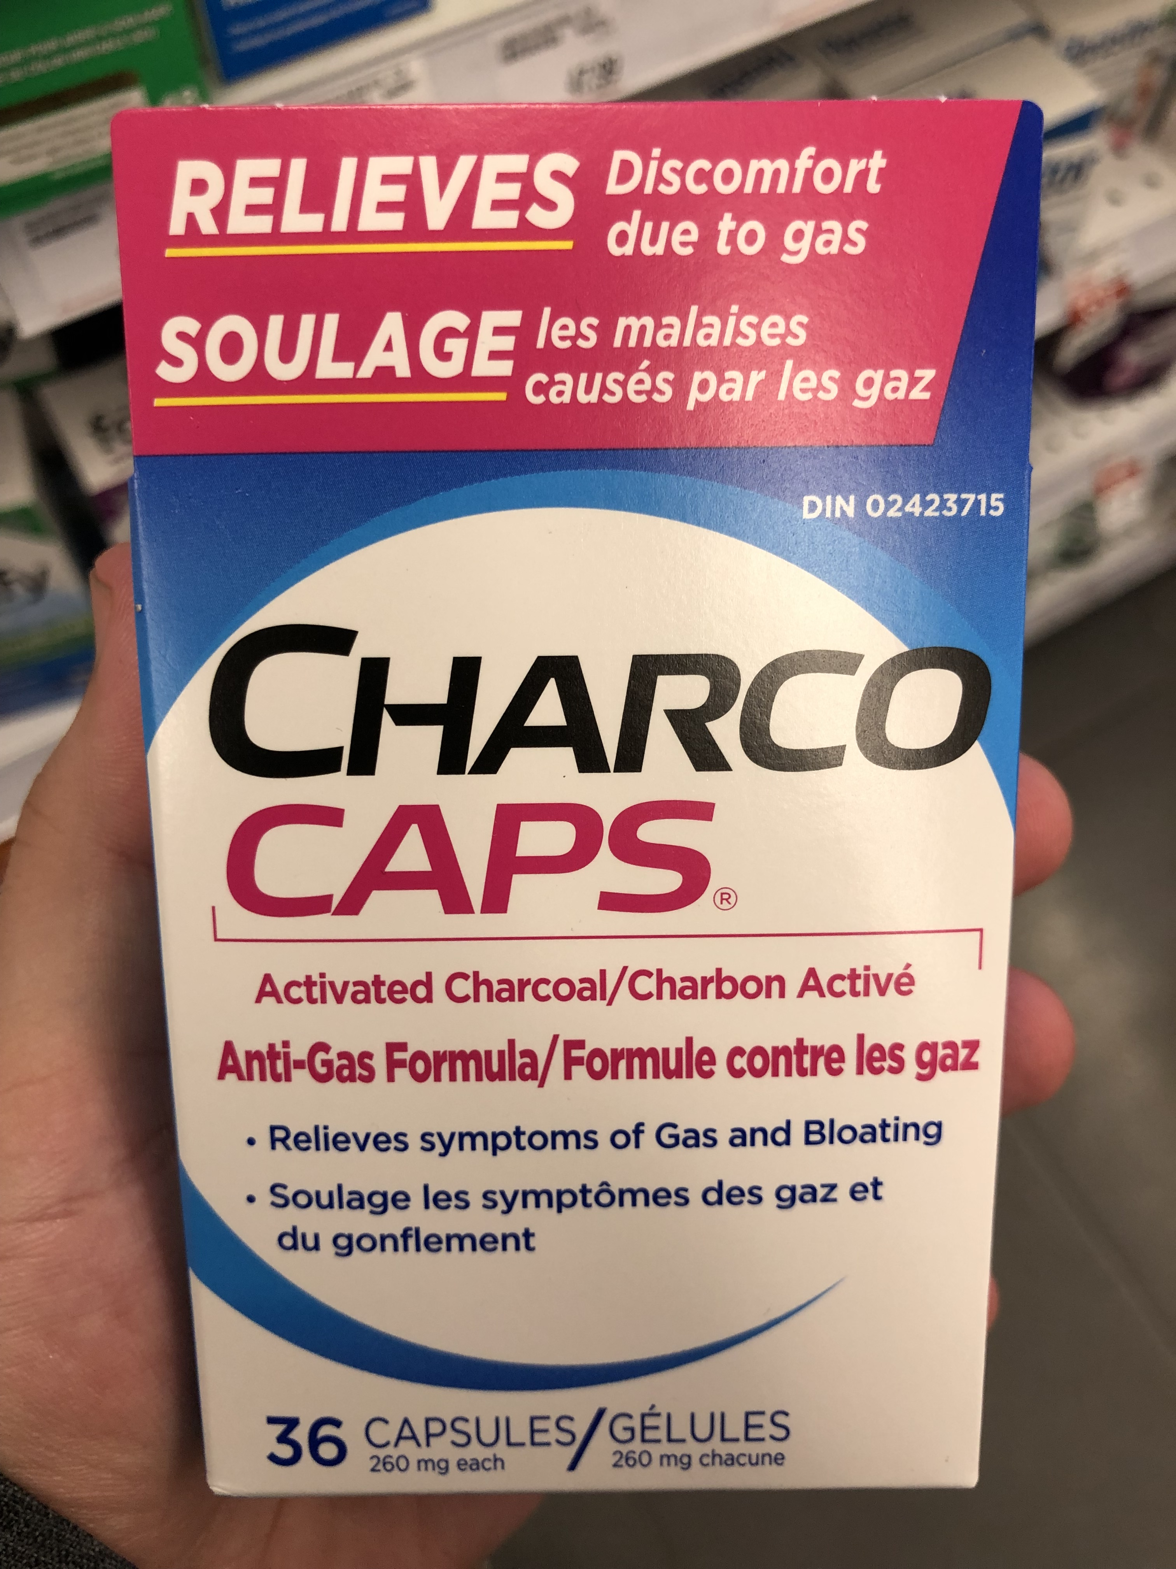
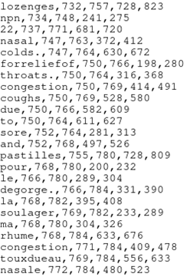

Slide 11
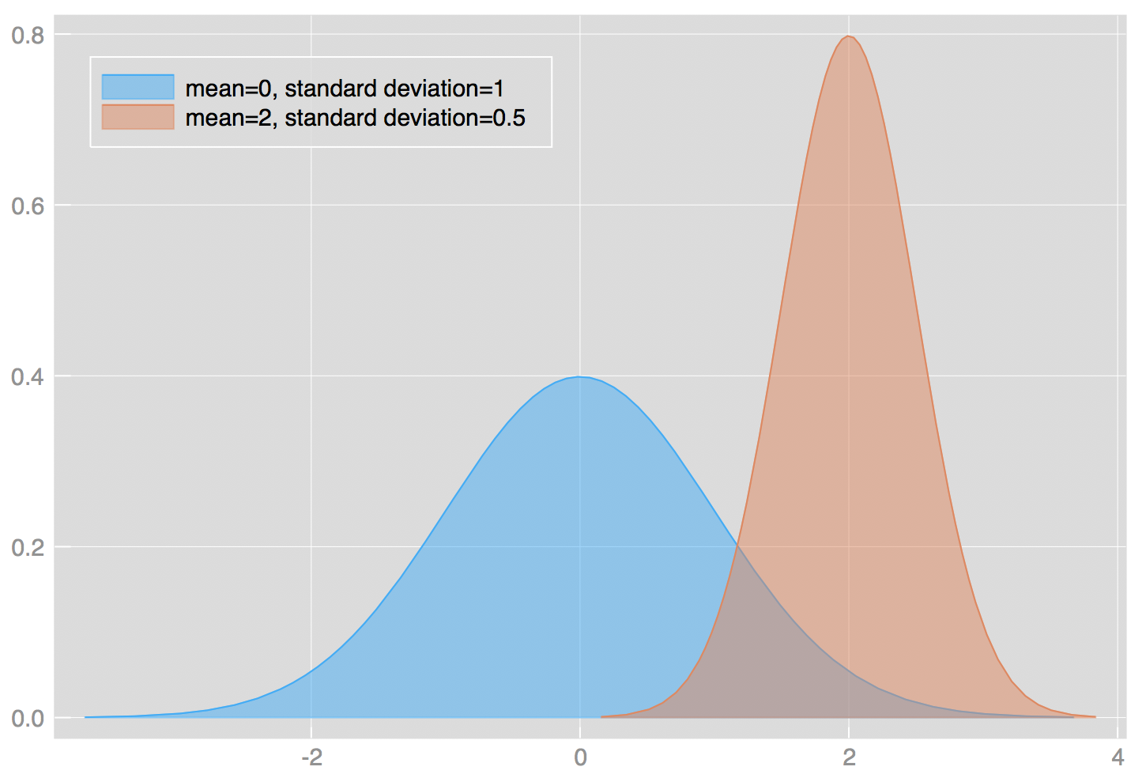
Discriminative Words: Claims vs Dosage vs …
For each relevant section (claims, dosage, ingredients, ...):
Construct a dictionary/lexicon
Determine discriminative words (e.g. P(Claim|word) >> P(Dosage|word)
Give relevance score towords based on discriminative ability
Use detected words + bbox for word to create a relevancy “heat map”
Use heat map to generate proposal bounding box for user
Claims
Dosage

Slide 14
Claim Detection Idea
We need the list of ~50k claim from licensed products,
Create a list of words that are discriminative enough to distinguish a claim in an image based on certain threshold.
Each word in that list will be given a score, e.g. their normalized frequencies, TfIdf, etc.
Use that list to identify “hot” regions in each image that is more likely to contain a claim.
Create a bounding box around that “hot” region.

Slide 15
Next Steps
DScD: Continue with more pre-trained OCR models,
DScD: Once having access to the existing claims, create a discriminative list to tackle claim detection.
HC: Give us access to the claims (~50k) of licensed products,
HC: Help DScD to crop the dosage portions of existing images,

Slide 16
Thank you!

